Slide 1
How did bronze replace stone in the Bronze Age?

Slide 2
Welcome to the Bronze Age: How did bronze replace stone?
Objectives
To know how the Bronze Age was different to the Stone Age
To explain how the smelting process was used to make bronze

Slide 3
Bronze vs. Stone
What differences can you think of between bronze and stone?
``````````````

Slide 4
What is bronze?
Bronze is an alloy (two metals mixed together), made up of 90% copper and 10% tin.
Bronze can easily be melted and poured into moulds to make different things like weapons or tools. It is also really hard when set and this makes it useful because it doesn’t break into pieces easily.
The discovery and wider use of bronze improved life in many ways and marked the end of the Stone Age and the beginning of the Bronze Age.
What else can you think of that is made out of bronze?

Slide 5
Back to the Bronze Age!
BC | AD
0
Look at the timeline.
Can you work out:
When did the Bronze Age start?
When did the Bronze Age end?
What came after the Bronze Age
How long was the Bronze Age?

Slide 6
What was so good about bronze?
The introduction of bronze was such a significant change that this period of history is named after it! But what was so good about bronze?
Match up the cards to work out some of the reasons that making things out of bronze meant such significant change for society.

Slide 7
How was bronze made?
Bronze is not a natural material like stone but instead it had to be made. The process of making bronze, was called ‘smelting’.
Watch this video to find out more about more about how smelting worked:
https://www.bbc.com/teach/class-clips-video/discovering-metalwork-in-bronze-age-britain/zb8b47h

Slide 8
Smelting Process: Step 1
Find rocks containing the metals tin and copper (called ‘ores’)

Slide 9
Smelting Process: Step 2
Make a really hot fire and heat the rocks

Slide 10
Smelting Process: Step 3
Extract the pure metals from the heated rocks

Slide 11
Smelting Process: Step 4
Mix together the molten copper and tin to make liquid bronze

Slide 12
Smelting Process: Step 5
Pour the hot liquid bronze into a mould to set in shape

Slide 13
Smelting Process
Your task is to make your own flow diagram to explain the bronze-making process.
You need to include all five steps in the correct order.

Slide 14
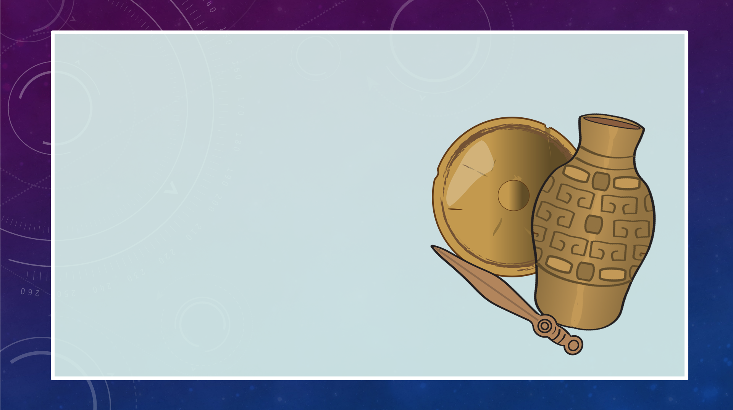
Spot Check
Tell someone in your house, 3 reasons why bronze was more useful than stone

Slide 15
Stone Age to Bronze Age
Imagine you meet a time traveller who has travelled from the Stone Age to the Bronze Age.
Think of some questions to ask them about what some of the differences are between the two periods.

Slide 16
Something to think about….
Many people think that bronze was first brought to Britain by an influx of newcomers who came from mainland Europe.
These migrants are sometimes called The Beaker People because they were often buried with vessels that look like beakers or mugs.
If you could travel to Bronze Age Britain and bring the people something useful that they had not yet discovered, what brilliant things would you introduce?

